Slide 1

Network expansion of genetic associations defines a pleiotropy map of human cell biology
Barrio-Hernandez et al.
Presentor: Wanjun Gu, Baranzini Lab
QBC Journal Club
Oct 1st, 2024

Slide 2
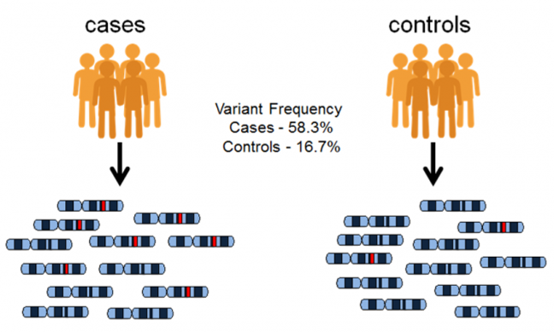
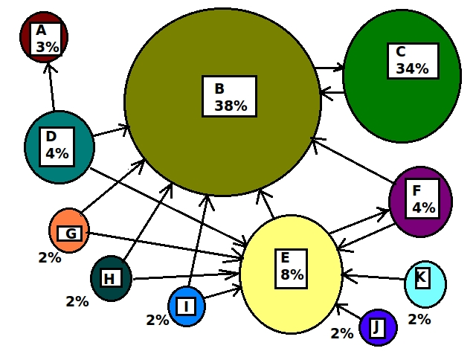
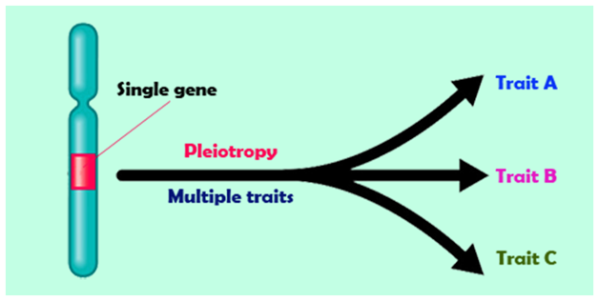
Background and motivation
Gnome-wide association studies (GWAS)
Pleiotropy
Network expansion
Notes:
Simple Explanation: The figure shows how many connections (edges) and elements (nodes) are in different parts of the interactome, which is a network of protein interactions. The largest component is from the STRING database, followed by the OTAR dataset. Smaller contributions come from IntAct, Reactome, and SIGNOR, showing how these sources combine to form a comprehensive network.

Slide 3
Component of the Knowledge Graph and Benchmark
Notes:
Simple Explanation: The figure shows how many connections (edges) and elements (nodes) are in different parts of the interactome, which is a network of protein interactions. The largest component is from the STRING database, followed by the OTAR dataset. Smaller contributions come from IntAct, Reactome, and SIGNOR, showing how these sources combine to form a comprehensive network.

Slide 4
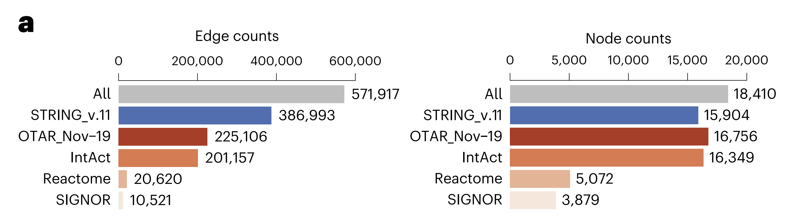
Panel a: Edge and Node Counts of the Combined Interactome
Description: This panel compares the number of edges (left) and nodes (right) in different components of the combined interactome.
Notes:
Simple Explanation: The figure shows how many connections (edges) and elements (nodes) are in different parts of the interactome, which is a network of protein interactions. The largest component is from the STRING database, followed by the OTAR dataset. Smaller contributions come from IntAct, Reactome, and SIGNOR, showing how these sources combine to form a comprehensive network.

Slide 5
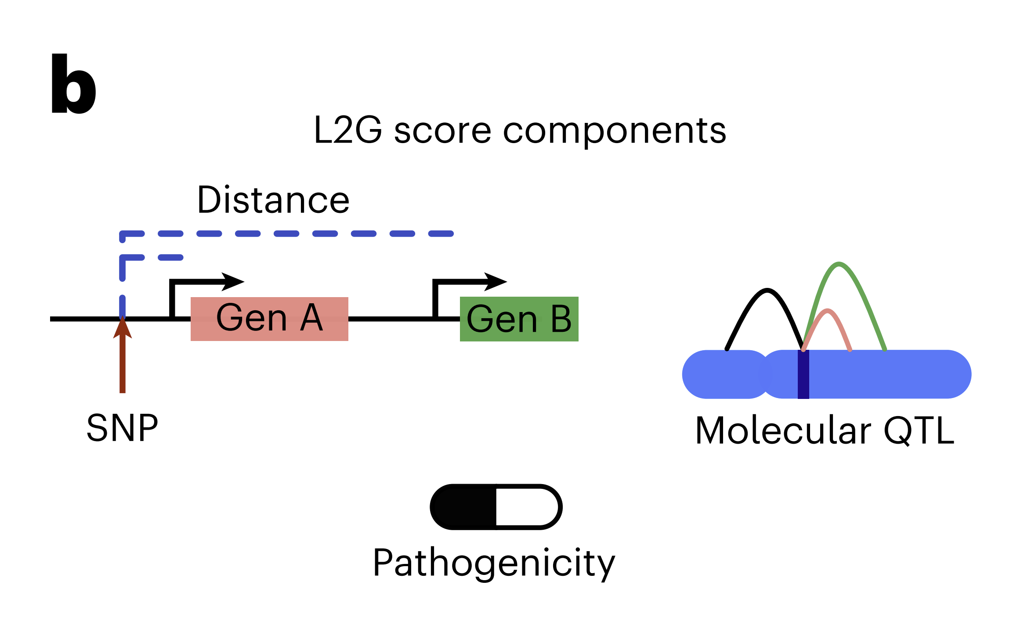
Panel b: L2G Score Components
Description: This panel graphically represents the components that contribute to the Locus-to-Gene (L2G) score, including SNP-to-gene distance, molecular QTL, and pathogenicity predictions.
Notes:
Simple Explanation: This panel shows the factors considered when predicting which genes might be causing a trait based on genetic data. It includes how close a genetic variant (SNP) is to a gene, how this affects the gene’s expression, and how likely the gene is to be involved in disease.

Slide 6
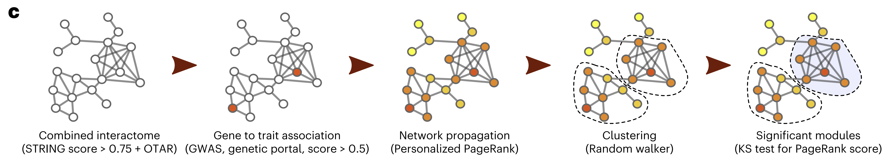
Panel c: Network-Based Approach
Description: This panel outlines the network-based method used to expand GWAS results, starting from combining interactome data, linking genes to traits, propagating this information through the network, clustering gene communities, and identifying significant modules.
Notes:
Simple Explanation: This part explains the steps taken to use a network of protein interactions to find new genes that might be linked to traits or diseases. It starts by connecting genes to traits, spreads this information through the network, groups similar genes together, and then identifies the most important gene groups.

Slide 7
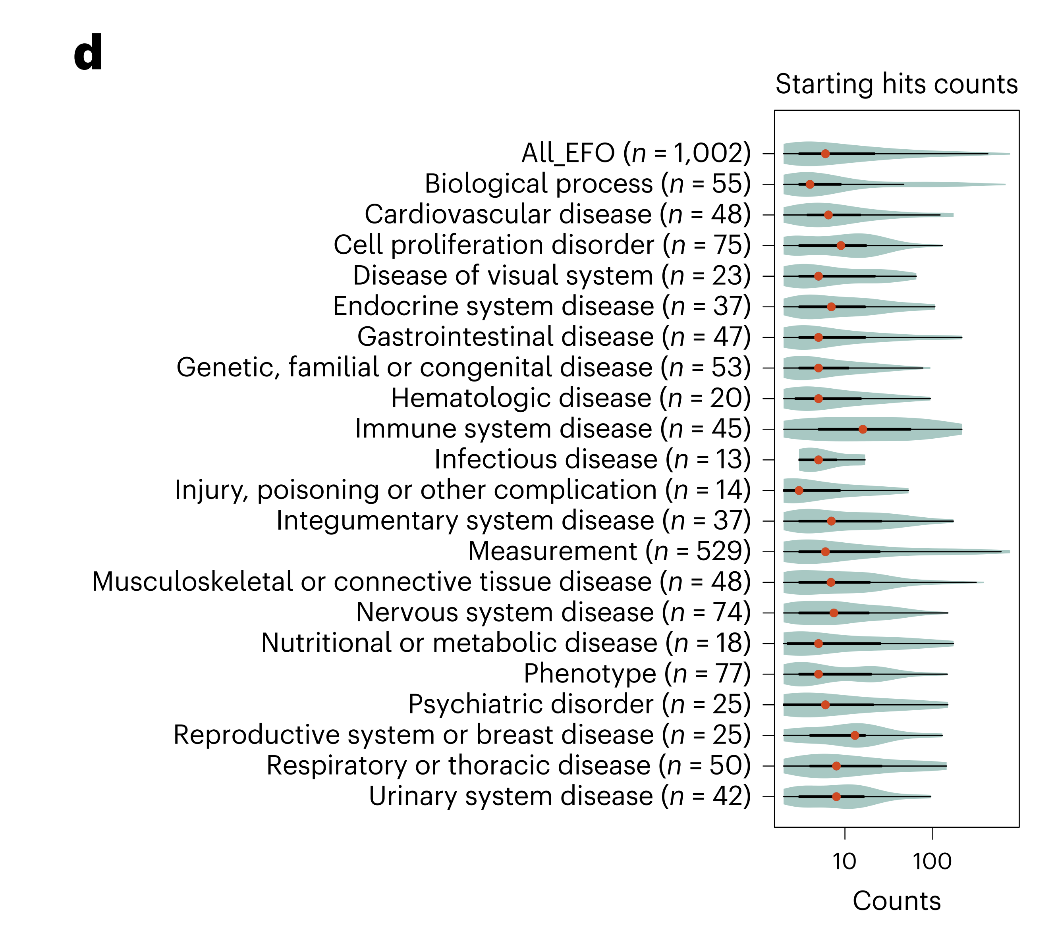
Panel d: Number of Starting Genes Linked to Traits
Description: This violin plot shows the distribution of the number of starting genes linked to different therapeutic areas, with the median and quartiles indicated.
Notes:
Simple Explanation: This plot shows how many genes are initially linked to different types of diseases or traits. Each type of disease has a different number of starting genes, and the plot gives an idea of the range and median number of these genes.

Slide 8
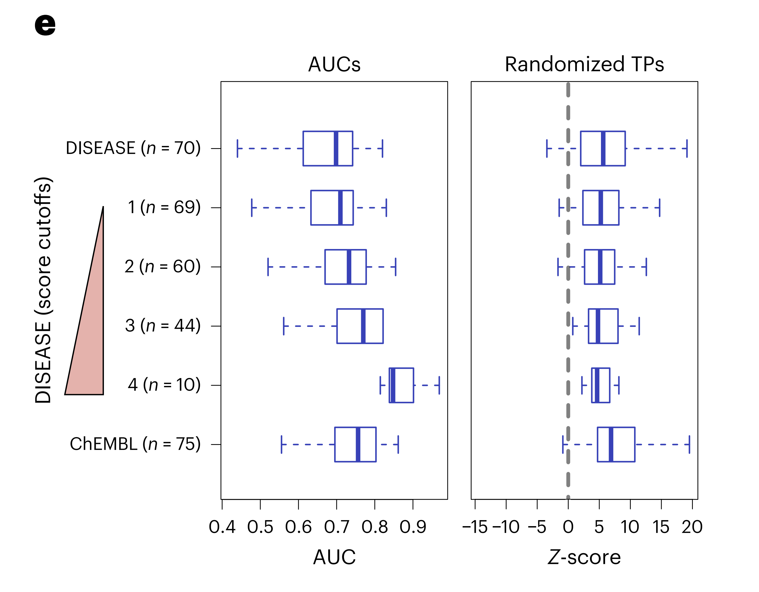
Panel e: Benchmarking the Method
Description: The panel contains boxplots comparing the area under the curve (AUC) and Z-scores for disease-associated genes, showing the performance of the network expansion method against random benchmarks.
Notes:
Simple Explanation: This final panel shows how well the network approach predicts disease-related genes compared to random chance. The higher scores mean the method is effective in finding relevant genes, which are also potential drug targets.

Slide 9
1002 Traits Clustered Based on Network Expansion
Notes:
Simple Explanation: The figure shows how many connections (edges) and elements (nodes) are in different parts of the interactome, which is a network of protein interactions. The largest component is from the STRING database, followed by the OTAR dataset. Smaller contributions come from IntAct, Reactome, and SIGNOR, showing how these sources combine to form a comprehensive network.

Slide 10
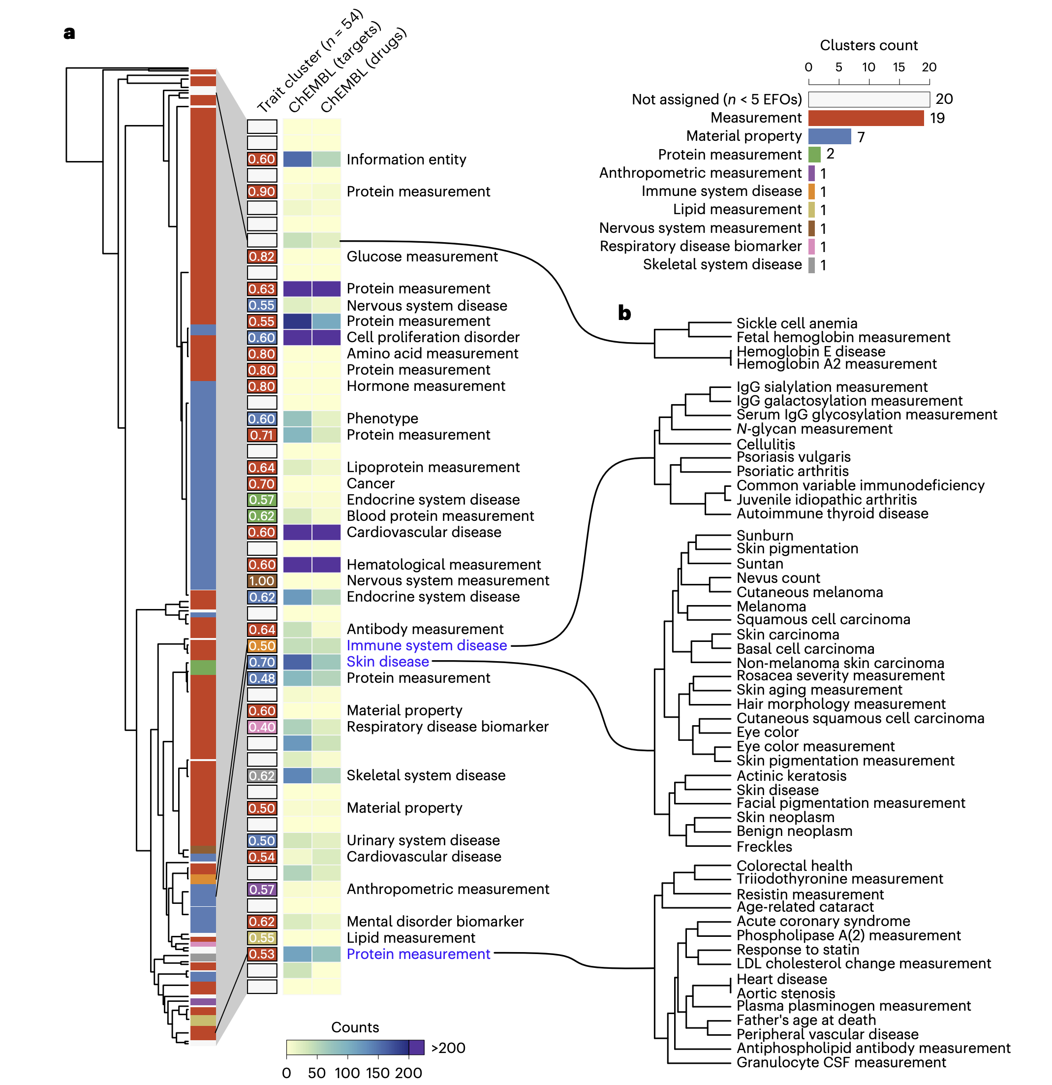
Panel a: Trait Clusters Based on Network Expansion Scores
Description: This panel presents a tree (dendrogram) showing the hierarchical clustering of 1,002 traits based on their network propagation scores. Traits are grouped into 54 clusters, color-coded according to the predominant Experimental Factor Ontology (EFO) ancestry term. The heatmap on the right shows the distribution of these clusters across different EFO categories.
Notes:
Simple Explanation: The tree shows how different traits or diseases are related based on the genes they share. By looking at how these traits group together, scientists can see which traits might have similar genetic causes. The heatmap highlights how these groups of traits fall into different categories, like measurements, diseases, or other characteristics.

Slide 11
Panel a: Trait Clusters Based on Network Expansion Scores
The heatmap on the right shows the distribution of these clusters across different EFO categories.

Slide 12
Panel b: Examples of Trait Clusters
Description: This panel zooms in on specific clusters from the tree shown in Panel a, providing examples of related traits grouped together by their Manhattan distance.
Examples:
Skin diseases,
Immune-related conditions
Cardiovascular diseases, etc.
Notes:
Simple Explanation: This part shows close-up examples of groups of traits that are genetically similar. For instance, it shows how certain skin conditions or immune diseases are grouped together because they share common genetic factors. This helps researchers understand which diseases might be treated similarly or have similar causes.

Slide 13
Network Expansion Reveals Pleiotropic Gene Modules
Notes:
Simple Explanation: The figure shows how many connections (edges) and elements (nodes) are in different parts of the interactome, which is a network of protein interactions. The largest component is from the STRING database, followed by the OTAR dataset. Smaller contributions come from IntAct, Reactome, and SIGNOR, showing how these sources combine to form a comprehensive network.

Slide 14
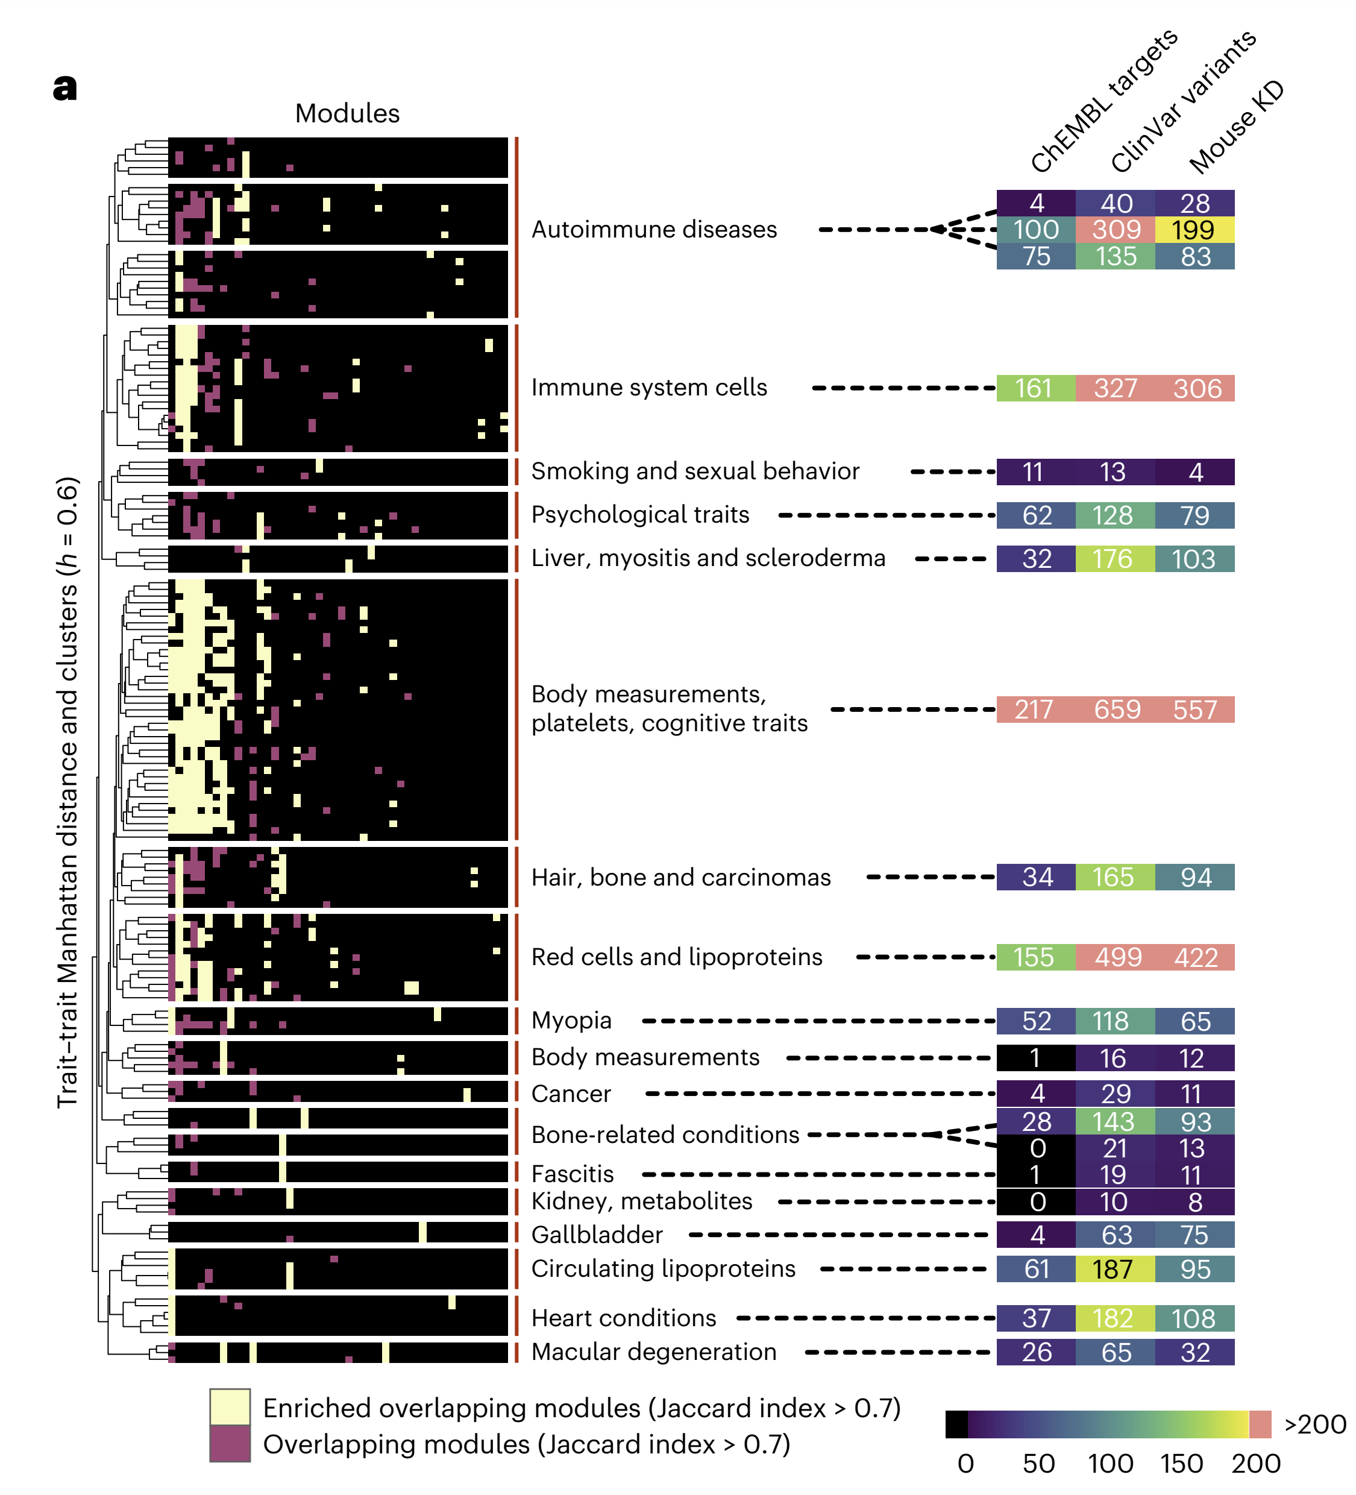
Panel a: Overlap Between Gene Modules Across Traits
Description: This panel shows a heatmap depicting the overlap between gene modules associated with various traits. The traits were clustered using hierarchical clustering, and subgroups were identified based on a correlation cutoff. The heatmap highlights modules that overlap significantly across traits, with specific focus on subgroups that are enriched for certain traits.
Notes:
Simple Explanation: This heatmap shows how groups of genes linked to different traits overlap with each other. It highlights areas where certain diseases or traits share a lot of genes, suggesting they might be connected through similar biological processes. For example, traits like autoimmune diseases, immune system cells, and psychological traits are grouped together, indicating potential shared genetic factors.

Slide 15
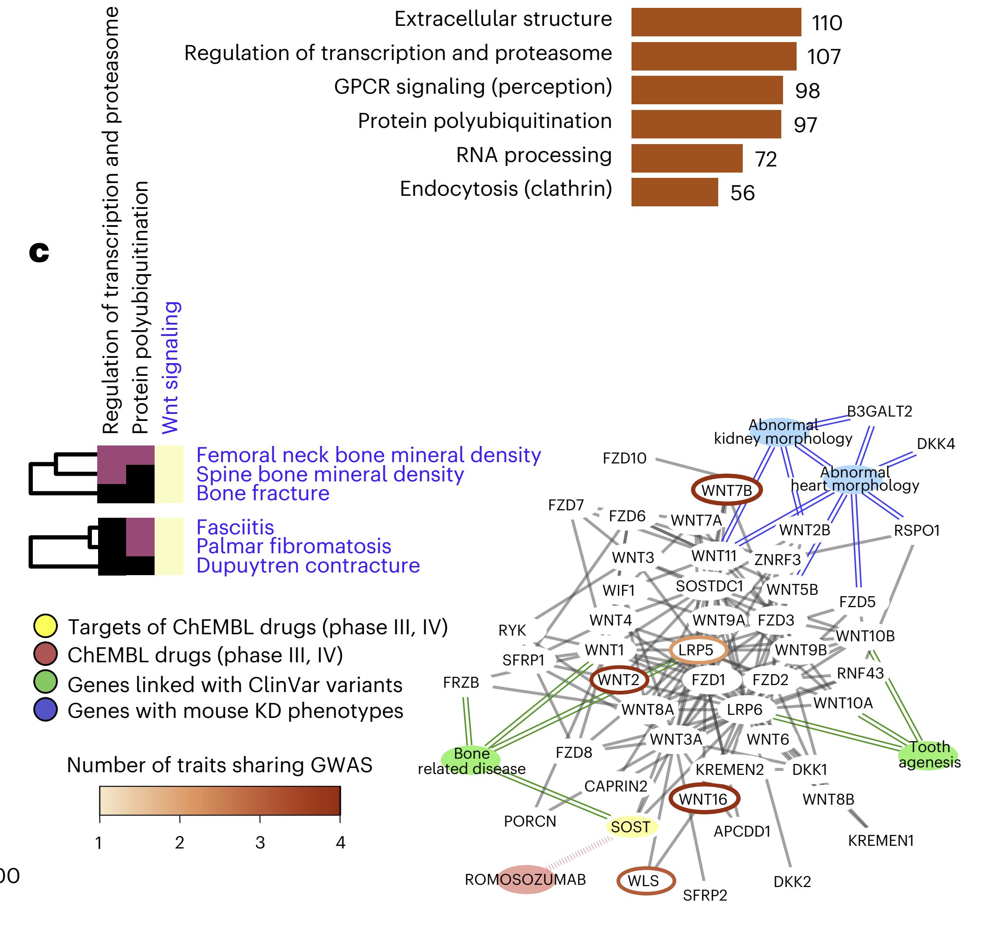
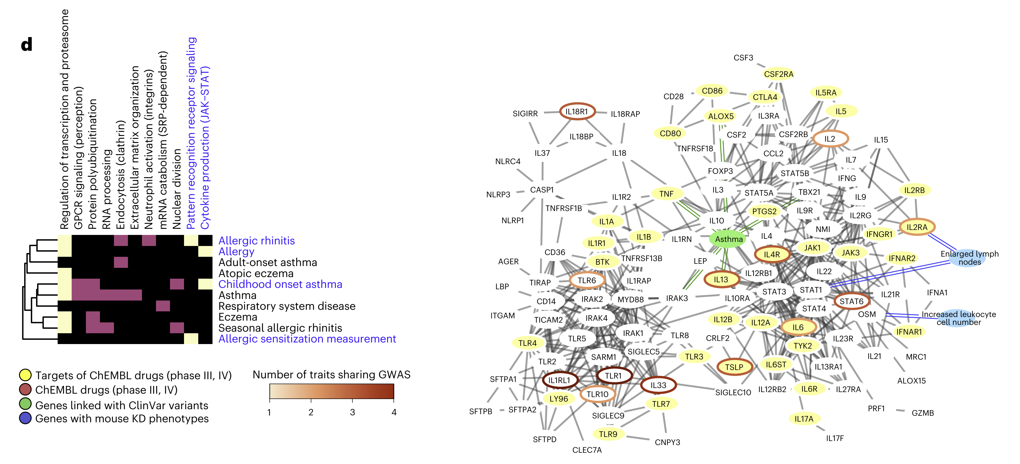
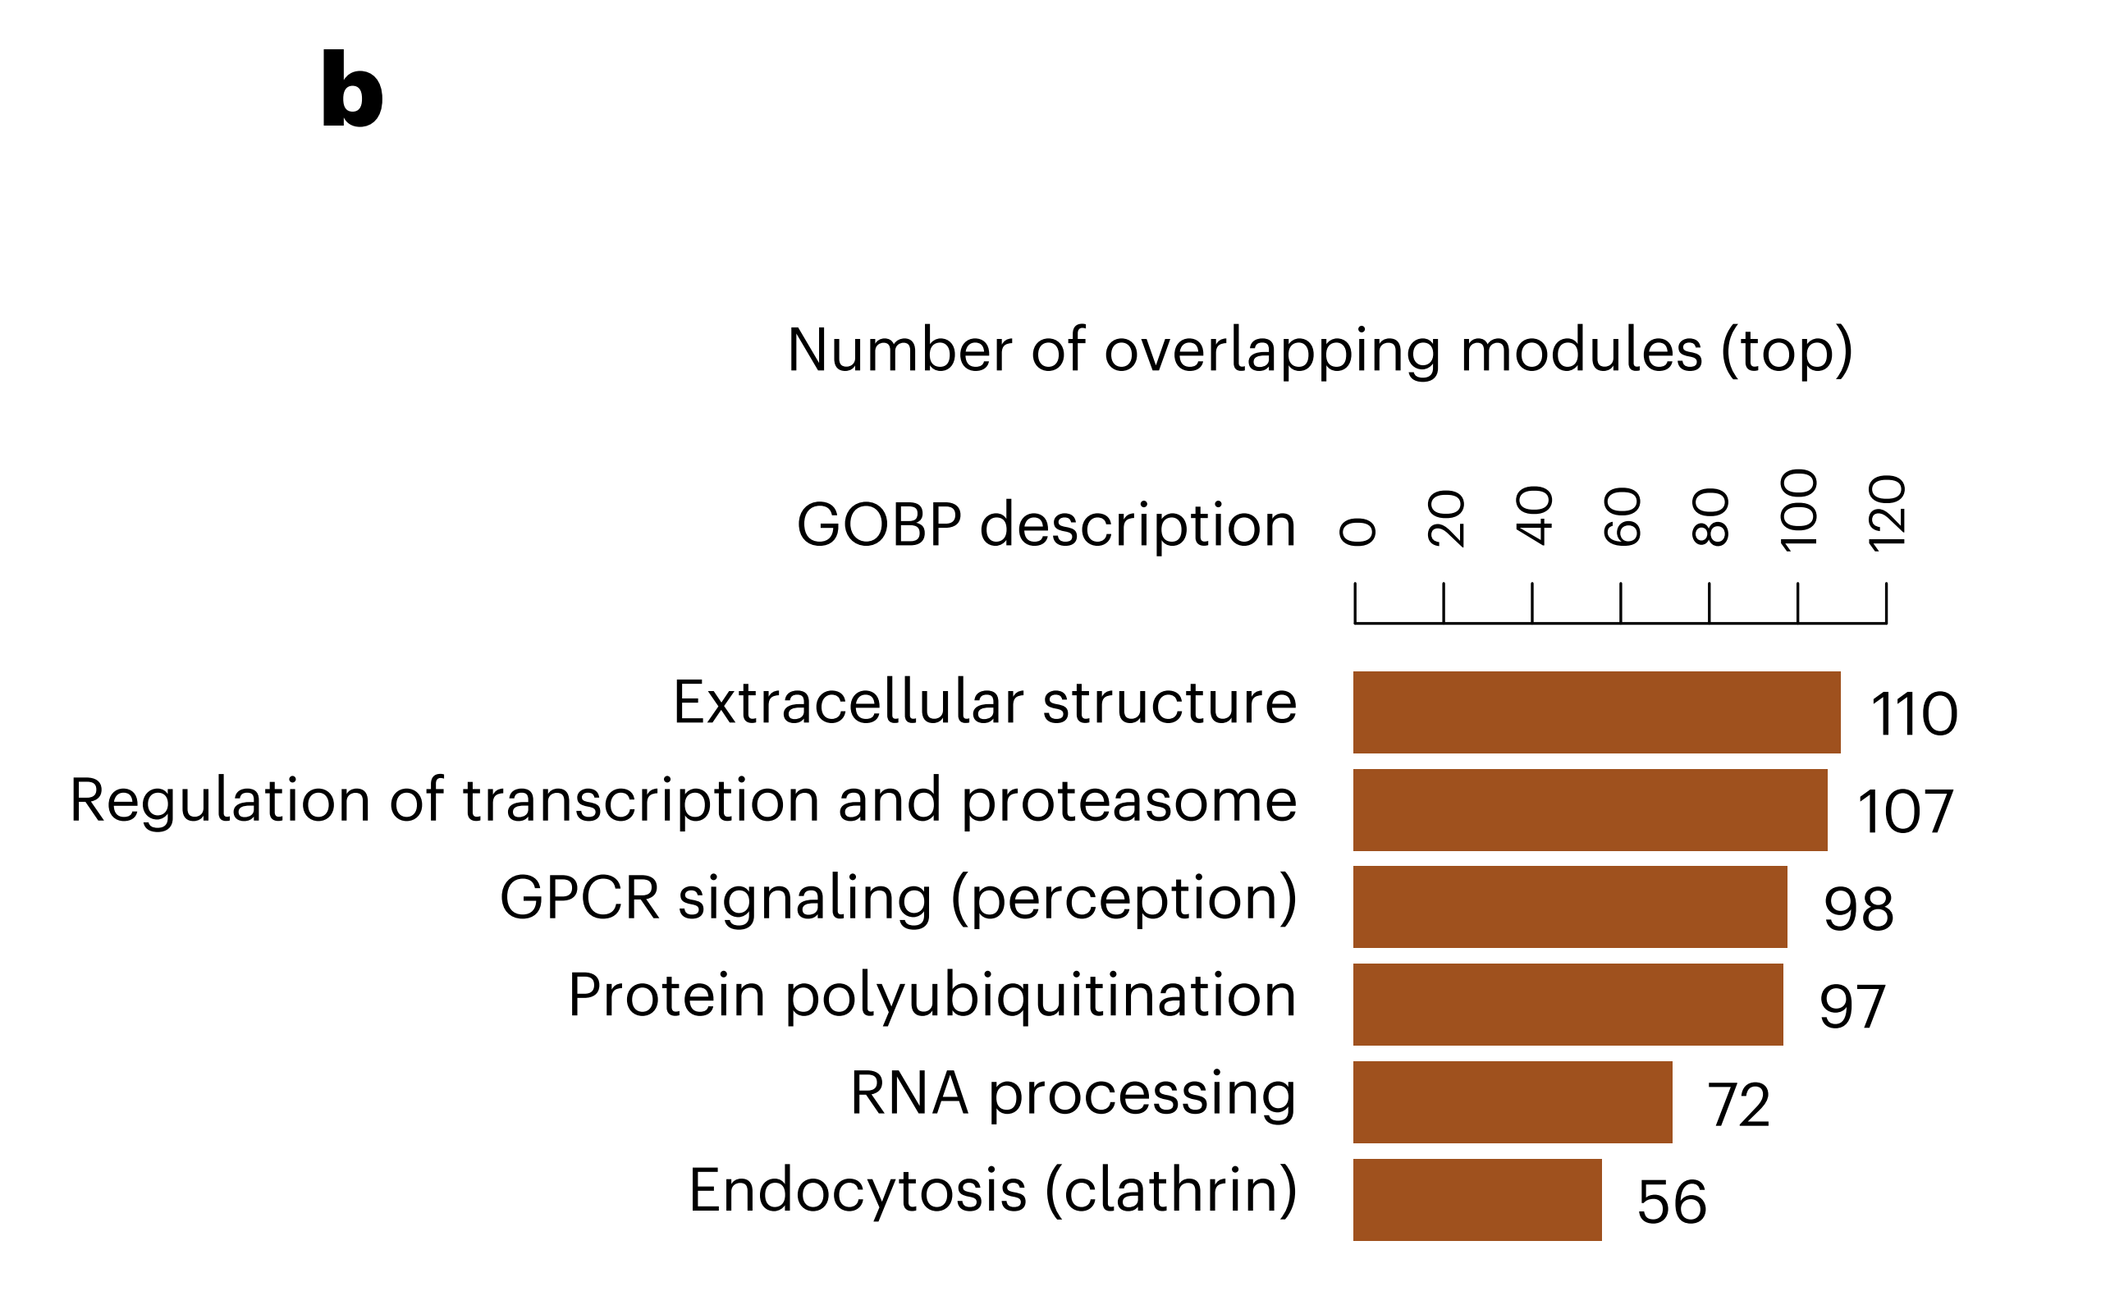
Panel b: Most Pleiotropic Gene Modules
Description: This shows the number of overlappinbarplotg gene modules across different traits and highlights the six most pleiotropic (i.e., genes associated with many traits) modules. These modules are involved in key biological processes such as extracellular structure, regulation of transcription, and protein polyubiquitination.
Notes:
Simple Explanation: This barplot identifies the gene groups that are involved in the most different traits. The figure emphasizes that certain biological processes, like how cells communicate or how proteins are modified, are common to many different diseases or traits, making them key areas to study for potential treatments.

Slide 16
Panel c: Simplified Heatmap and Network for Bone-Related Traits
Description: This panel provides a detailed look at a subset of the gene modules specifically linked to bone-related and fasciitis traits. It visualizes the network of interactions among genes in these modules, showing connections between genes, clinical variants, and drugs in clinical trials.
Notes:
Simple Explanation: This part focuses on bone-related diseases and shows a network of genes that are important in these conditions. It highlights how certain genes are targets for existing drugs, which could be repurposed for treating these diseases. The colors in the network indicate whether a gene is linked to clinical trials, known disease variants, or mouse studies, helping researchers pinpoint which genes might be most important for new treatments.

Slide 17
Panel d: Network for Allergic Diseases
Notes:
Simple Explanation: This part looks at allergies and related conditions, showing how genes in these diseases interact. Like the bone-related network, it highlights genes that could be important targets for new treatments, especially focusing on those already being tested in clinical trials or linked to known disease variants.

Slide 18
Network of Gene Modules in Immune Traits and Diseases
Notes:
Simple Explanation: The figure shows how many connections (edges) and elements (nodes) are in different parts of the interactome, which is a network of protein interactions. The largest component is from the STRING database, followed by the OTAR dataset. Smaller contributions come from IntAct, Reactome, and SIGNOR, showing how these sources combine to form a comprehensive network.

Slide 19
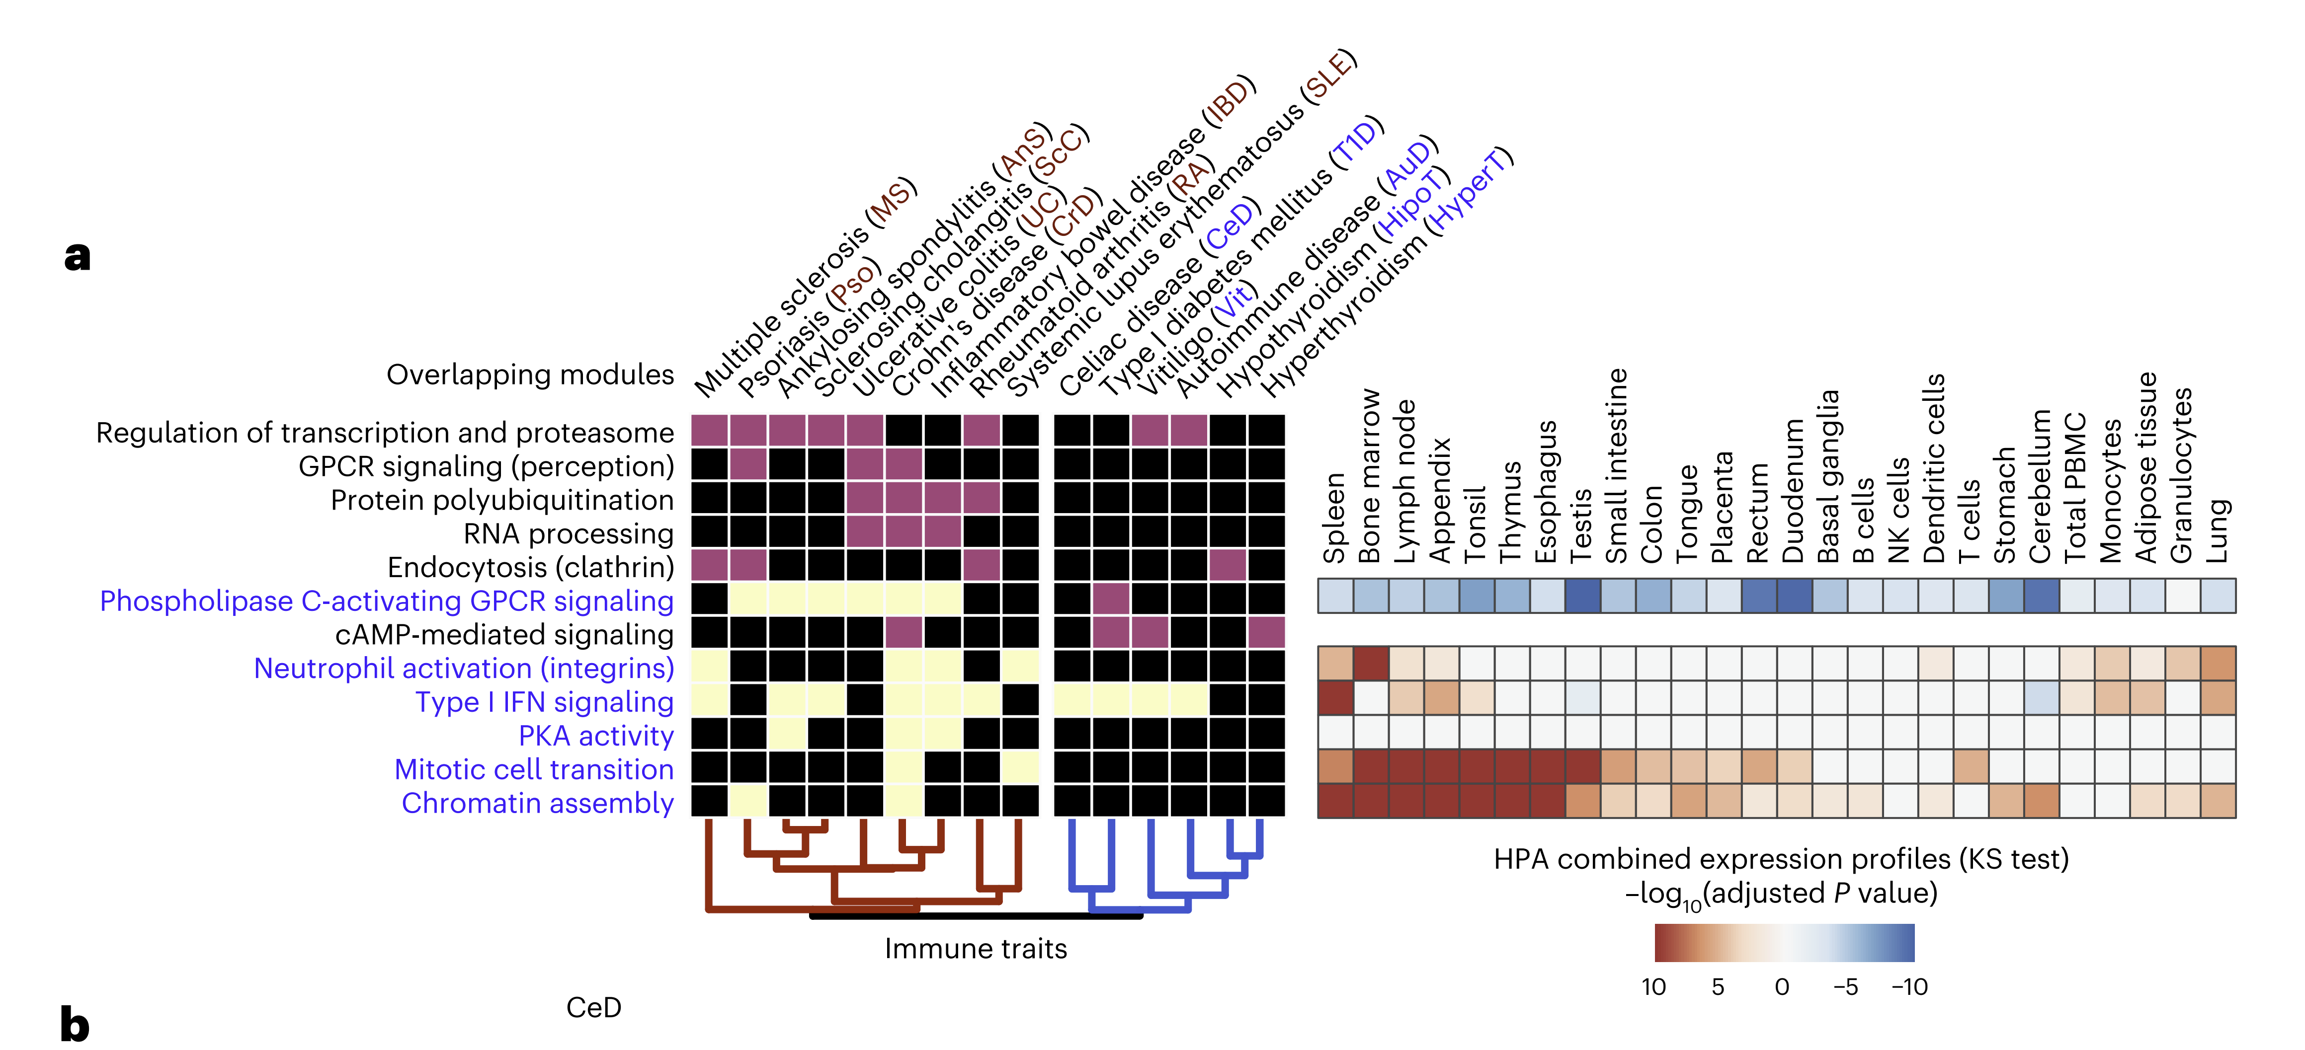
Panel a: Overlapping Modules and Gene Expression Profiles in Immune Traits
Notes:
Simple Explanation: The first heatmap shows how genes that are important in different immune-related diseases (like multiple sclerosis, rheumatoid arthritis, etc.) overlap. The second heatmap on the right shows where these genes are active in the body, such as in the spleen or bone marrow. This helps researchers understand which parts of the immune system are involved in these diseases.

Slide 20
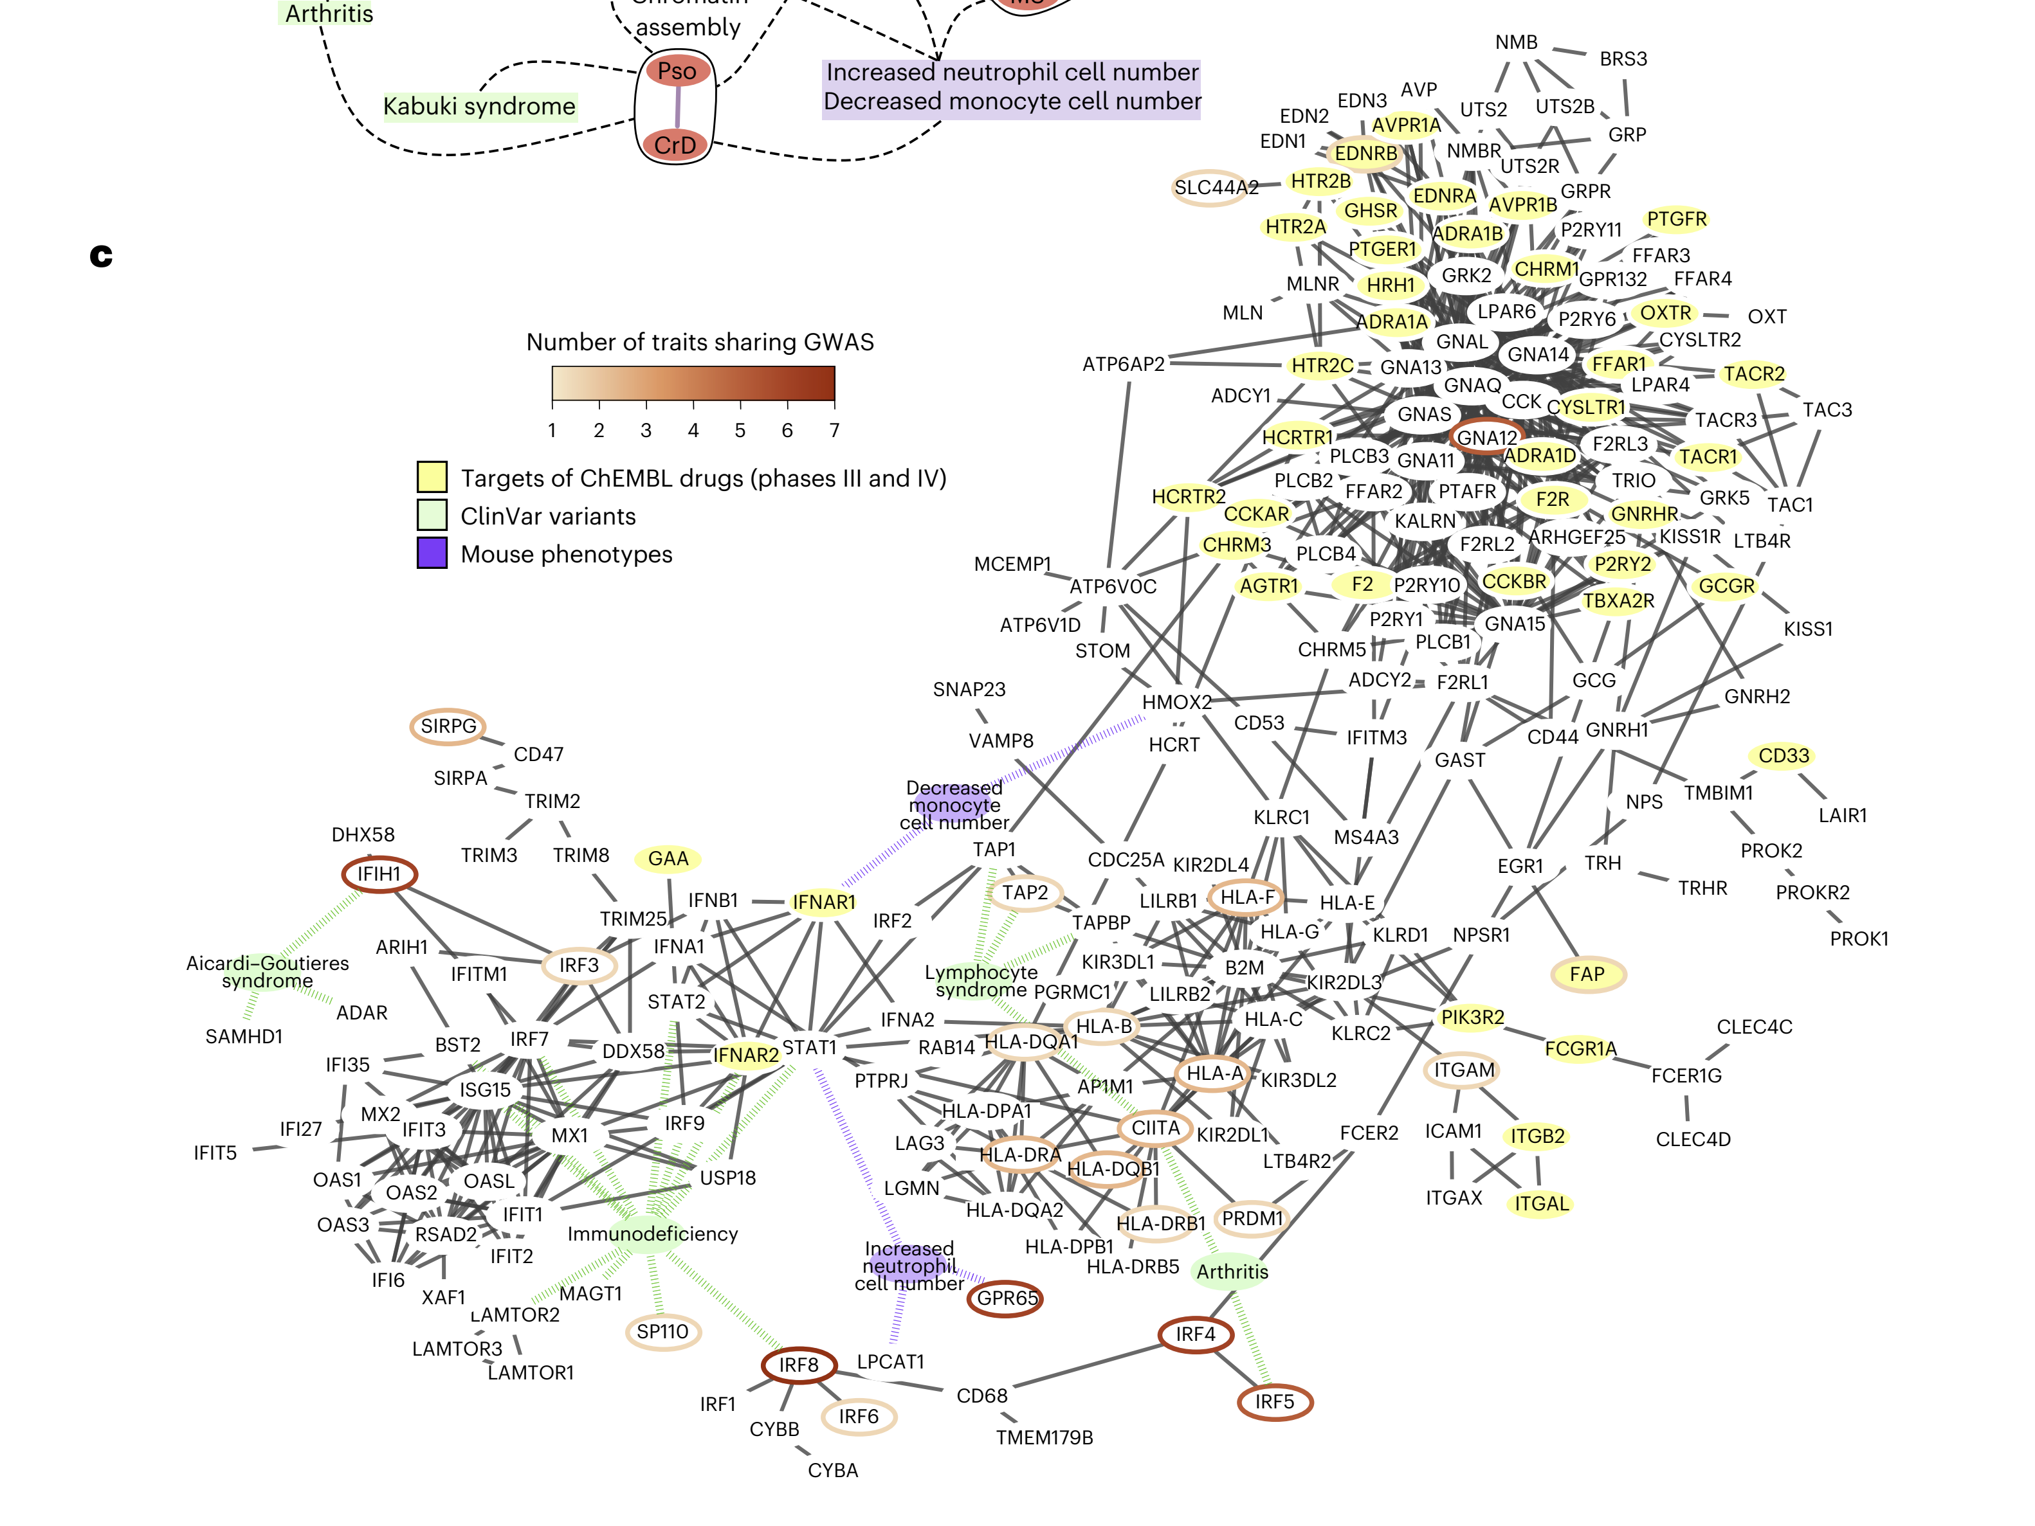
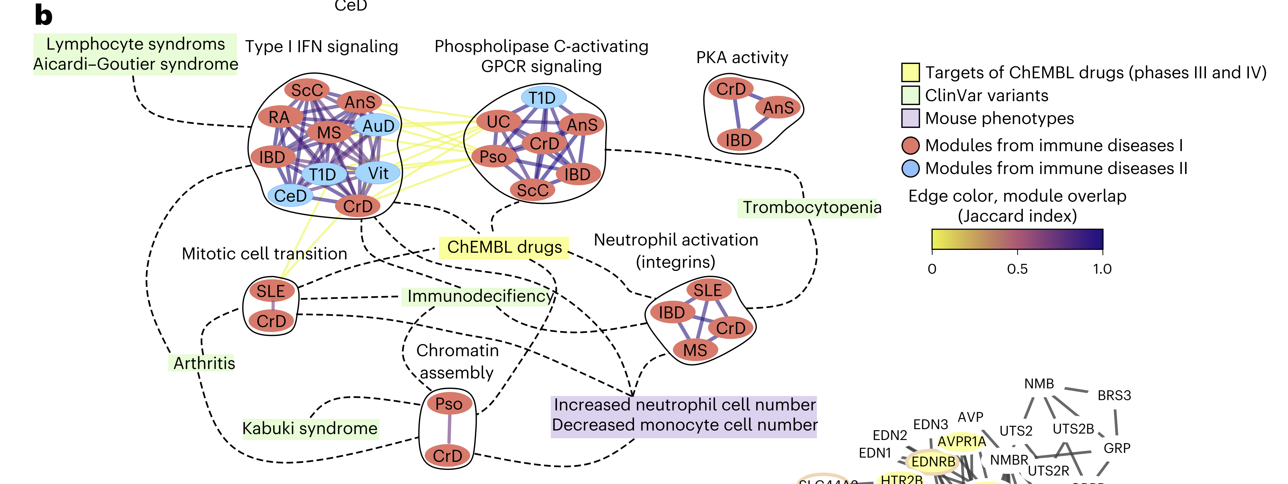
Panel b: Network of Gene Modules in Immune Diseases
Notes:
Simple Explanation: This network map shows how different groups of genes (modules) involved in immune diseases are connected. It highlights which genes are targets of drugs or have known roles in diseases. The colored circles and lines help to identify which genes are involved in multiple diseases, showing how these diseases might be related at the genetic level.

Slide 21
Panel c: Detailed Network for Key Immune-Related Gene Modules
Description: This panel zooms in on specific gene modules related to immune function, detailing their interactions and highlighting connections to clinical trials, disease variants, and mouse models. The nodes are colored based on their involvement in different immune traits, and the edges indicate the degree of overlap between modules.
Notes:
Simple Explanation: This part focuses on specific genes that are critical for immune system diseases. It shows how these genes interact with each other and highlights which ones are being tested in clinical trials or are known to be involved in diseases. This detailed map helps researchers find key targets for developing new treatments for immune-related conditions.

Slide 22
Network of Gene Modules in Inflammatory Bowel Disease (IBD)
Notes:
Simple Explanation: The figure shows how many connections (edges) and elements (nodes) are in different parts of the interactome, which is a network of protein interactions. The largest component is from the STRING database, followed by the OTAR dataset. Smaller contributions come from IntAct, Reactome, and SIGNOR, showing how these sources combine to form a comprehensive network.

Slide 23
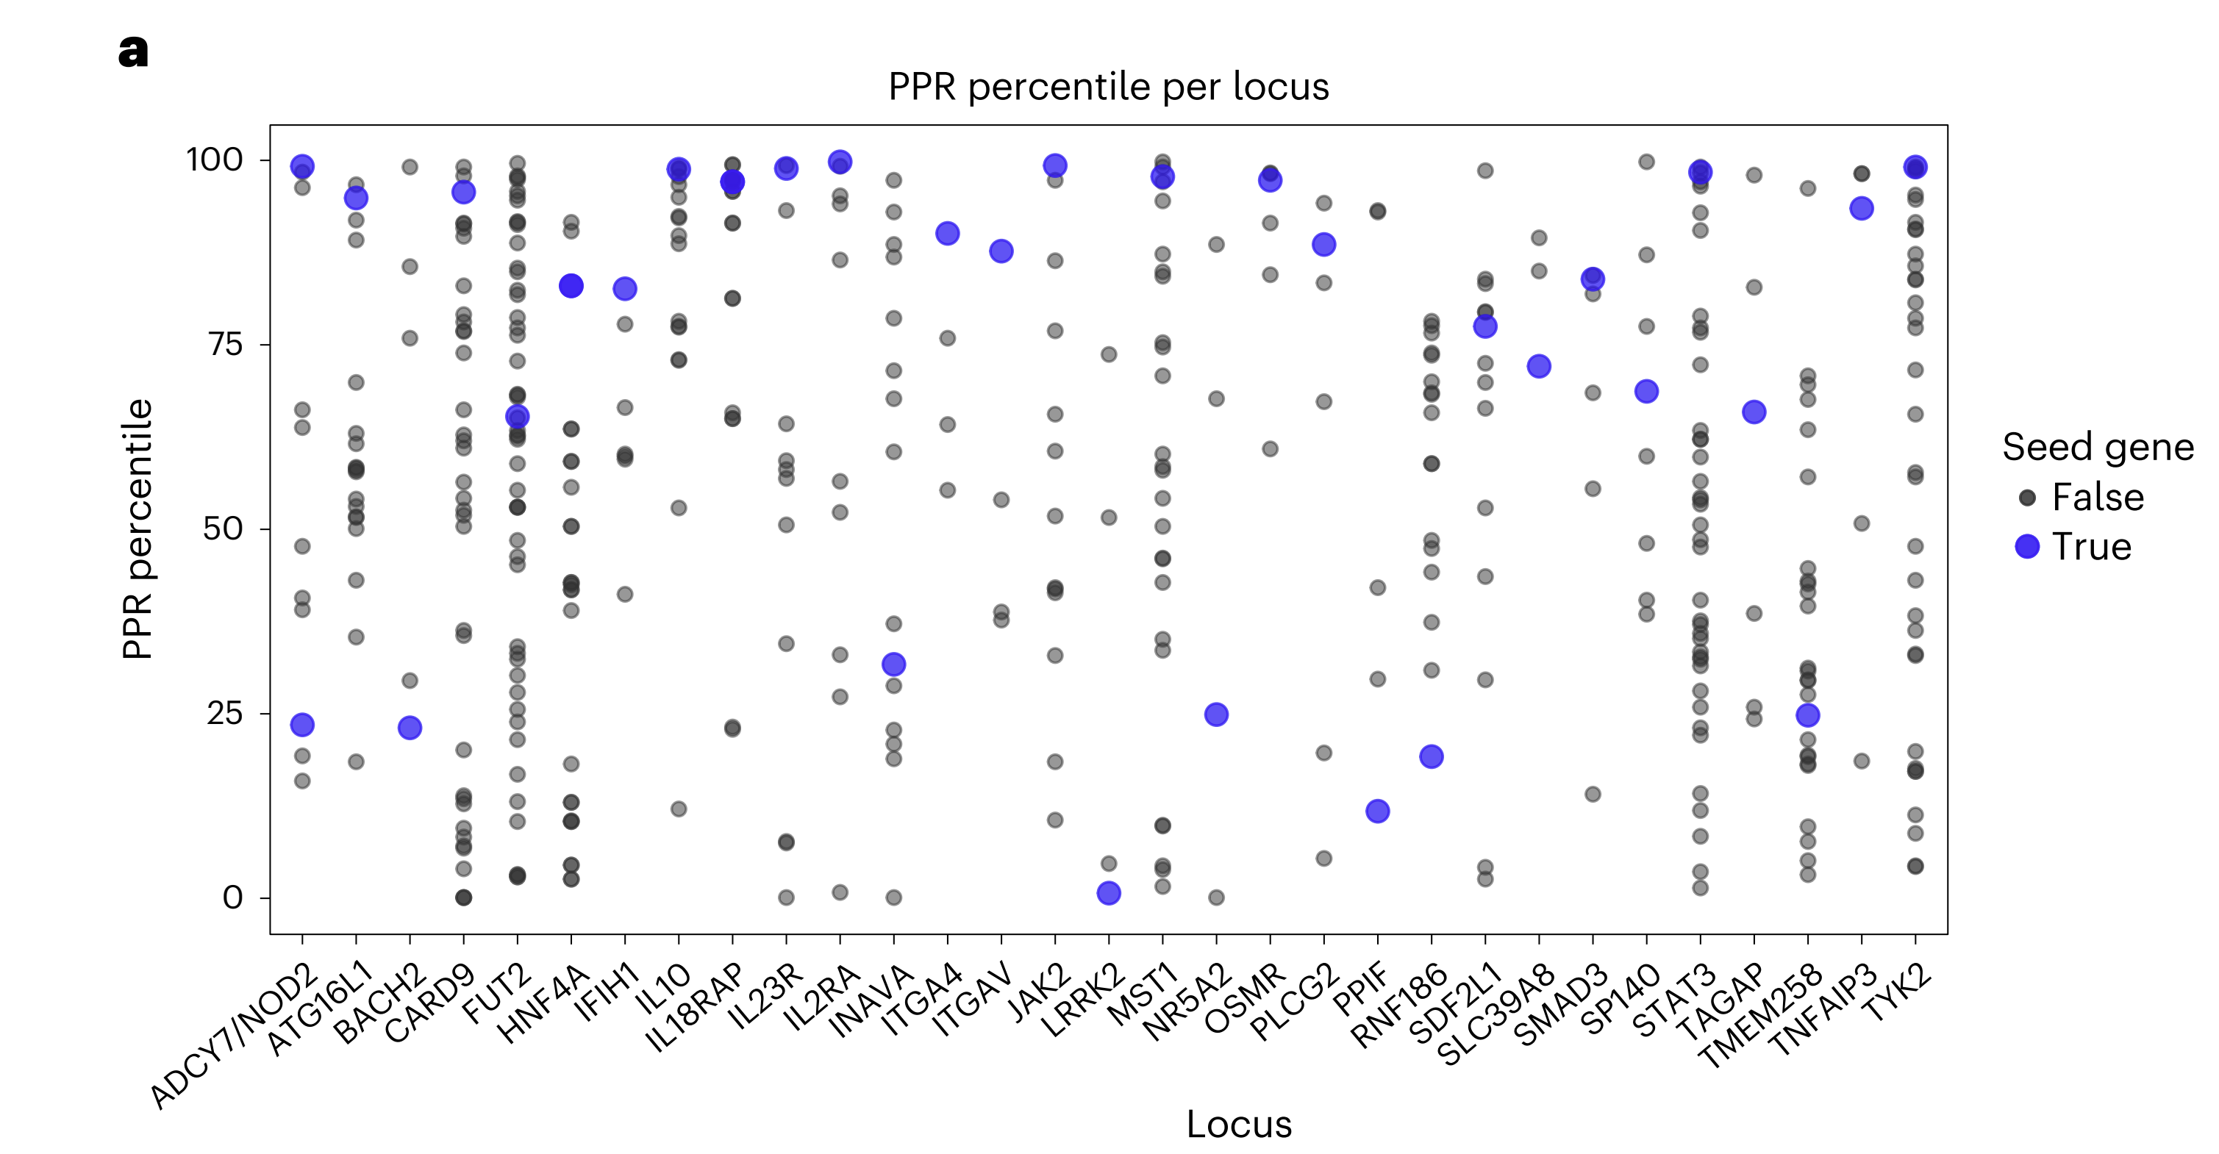
Panel a: PPR Percentile for IBD Loci
Description: This scatter plot shows the Personalized PageRank (PPR) percentiles for genes within specific IBD-associated loci. Seed genes (those known or suspected to be related to IBD) are marked in blue, while other genes are in gray.
Notes:
Simple Explanation: This plot compares the importance scores (PPR percentiles) of different genes linked to IBD. The higher the score, the more connected the gene is within the network of IBD-related genes. The blue dots highlight the genes already suspected to be important for IBD, showing that many of these have high scores, indicating strong connections.

Slide 24
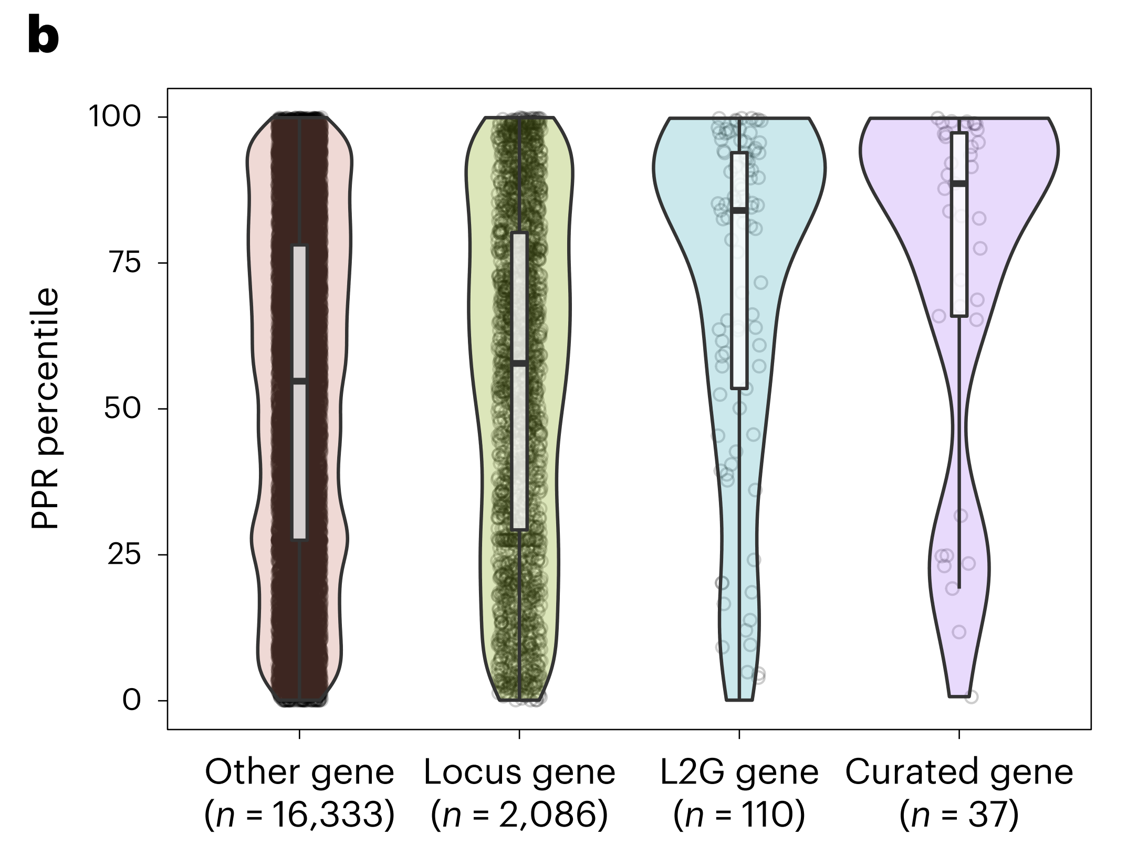
Panel b: Comparison of PPR Percentiles Across Different Gene Sets
Description: This violin plot compares the distribution of PPR percentiles across four groups: other genes (those not specifically linked to IBD loci), locus genes (all genes at IBD-associated loci), L2G genes (genes prioritized based on a locus-to-gene score), and curated genes (high-confidence IBD genes).
Notes:
Simple Explanation: This plot shows how different groups of genes rank in terms of their network scores. The more important the gene is considered (like curated IBD genes), the higher its score tends to be. This helps demonstrate that the network method is good at identifying important IBD genes because these genes tend to have higher scores.

Slide 25
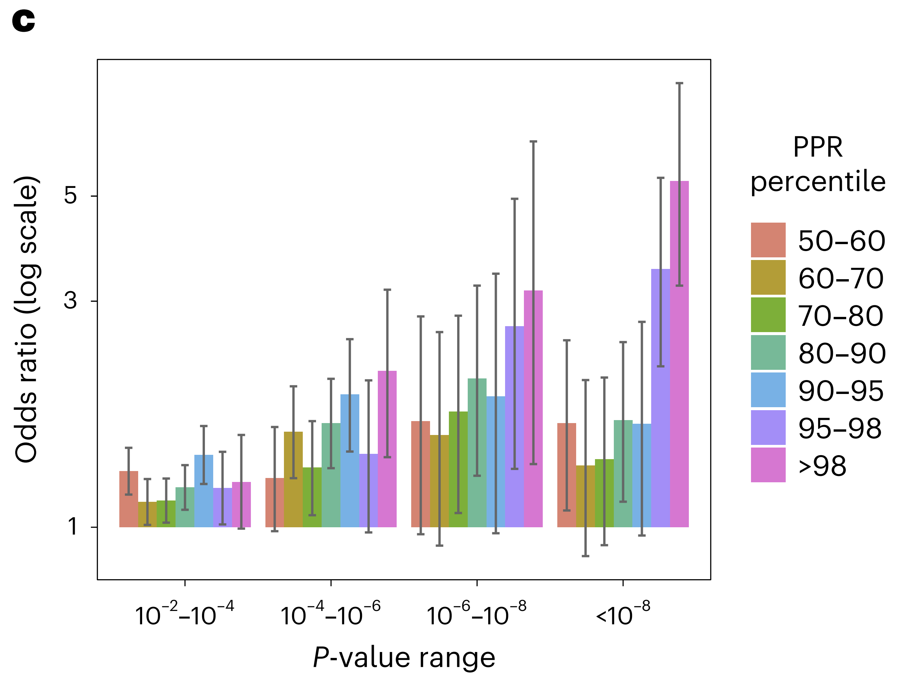
Panel c: Enrichment of Low p-Value SNPs Near High PPR Genes
Description: This bar chart shows the odds ratios (on a log scale) for finding low p-value SNPs (indicating strong genetic association) near genes with high PPR percentiles. The bars are color-coded based on PPR percentiles, with higher percentiles showing greater enrichment for low p-value SNPs.
Notes:
Simple Explanation: This chart indicates how likely it is to find strong genetic evidence (low p-value SNPs) near genes that have high importance scores in the network. The higher the score (PPR percentile), the more likely these genes are to be near significant genetic markers, supporting the idea that these genes are important for IBD.

Slide 26
Conclusions
Network expansion of GWAS is a powerful tool for the identification of genes and cellular processes linked to human traits
Application in multi-trait analysis can reveal pleiotropy of human biological pathways at the level of the organism
Network expansion can highlight new opportunities for drug development and repurposing
Notes:
Simple Explanation: The figure shows how many connections (edges) and elements (nodes) are in different parts of the interactome, which is a network of protein interactions. The largest component is from the STRING database, followed by the OTAR dataset. Smaller contributions come from IntAct, Reactome, and SIGNOR, showing how these sources combine to form a comprehensive network.

